Slide 1
The Story of the HEPAX Module
Steen Petersen
HPCC Conference London
October 2022

Slide 2
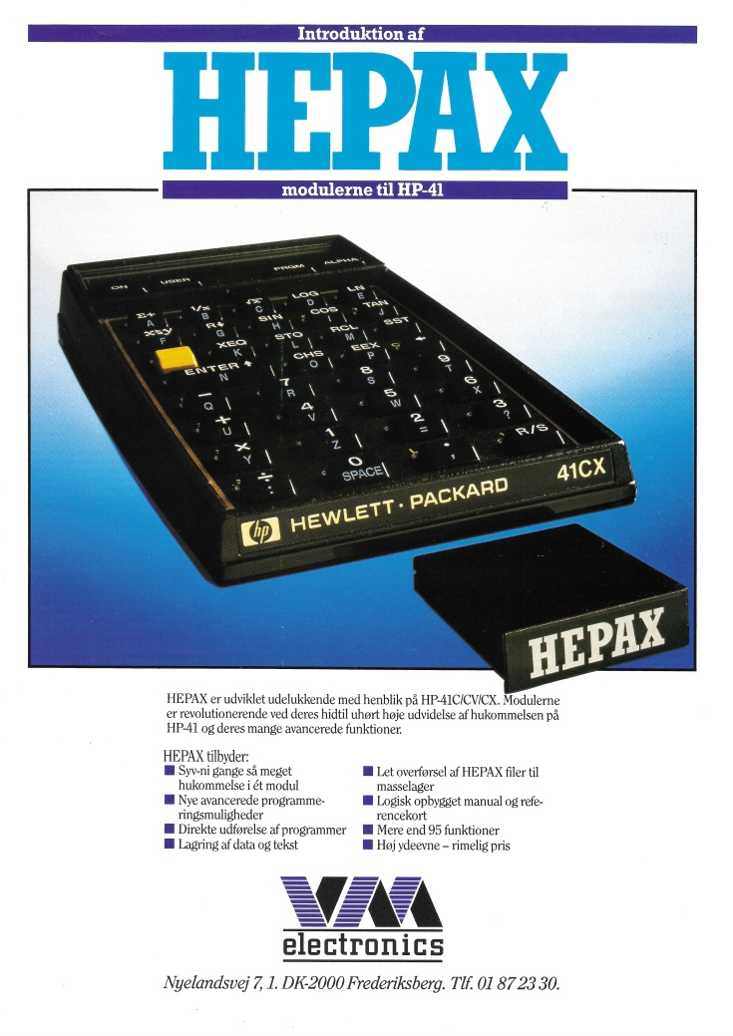
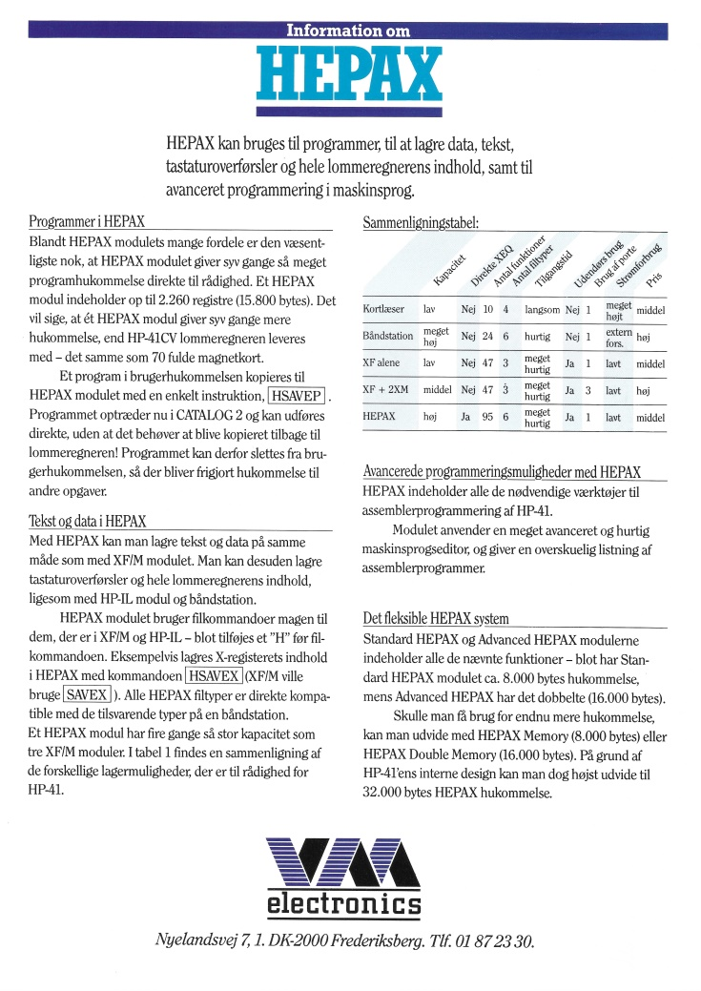
2

Slide 3
Introduction
May 2020 - I searched for HEPAX on the Internet – for the first time ever!
- and here I am…
HEPAX is short for HEwlett-PAckard 41 eXpansion
3

Slide 4
Early Days – How we got started
Met Sten Vesterli and Flemming Madsen at PPC Denmark membership meeting
Started VM Electronics to productize RAM/ROM box
Took over PPC Denmark leadership
Arranged The International Conference of HP Handheld Computer Users Copenhagen 1987
4

Slide 5
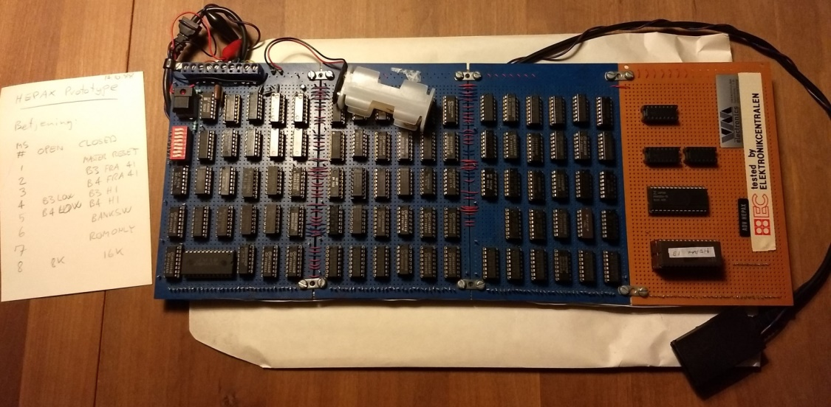
First Prototype
Shoebox with three 4 x 6-inch breadboards connected with rainbow ribbon cable
5

Slide 6
First RAM/ROM Boxes
RAM/ROM box product where we had a highly expandable product
First/main box housed the control logic as well as the ROM module and the connection to the HP-41 via a cable
RAM expansion box with 8 kBytes of RAM
We quickly realized a RAM/ROM box product the size of a stack of lunch boxes would not be very appealing
6

Slide 7
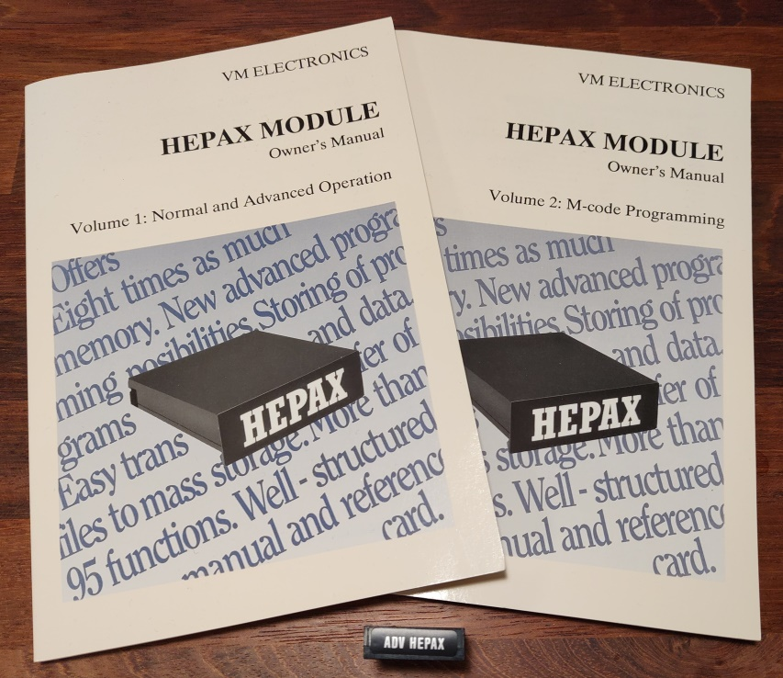
Finally, the HEPAX Modules
Back to the drawing board
Had to fit inside a standard HP-41 module size
Custom gate array design was not cheap
Needed a much bigger investment – loan from bank
7

Slide 8
The Hardware inside the HEPAX modules
Gate array and Surface mount EPROM and RAM modules
Three-layer ceramic substrate – one model with five “programmable” options
Connectors bought from HP
Local plastic expert made a mold for the housing – assembly was done here
8

Slide 9
The Software inside the HEPAX Modules
Extended Functions (XF) was inspiration but wanted programs to run without being retrieved
Needed to be very easy to use
MCODE support for the enthusiasts
Needed 16 kBytes to have enough room – added two more banks for bank switching
Automatic relocation of HEPAX ROM
9

Slide 10
The Software inside the HEPAX Modules
All the code was first written by hand on a blank piece of paper with a few comments
Entered it into the HP-41 using the ASM3 assembler – then debugging until satisfied
Developed good programming tools: DISASM / HEXEDIT
Made notes on paper of start and end of each function – then moved with HEXEDIT
Saved image on tape/disk with WRTROM / READROM
Only one function fully commented – resizing files across RAM block boundaries
10

Slide 11
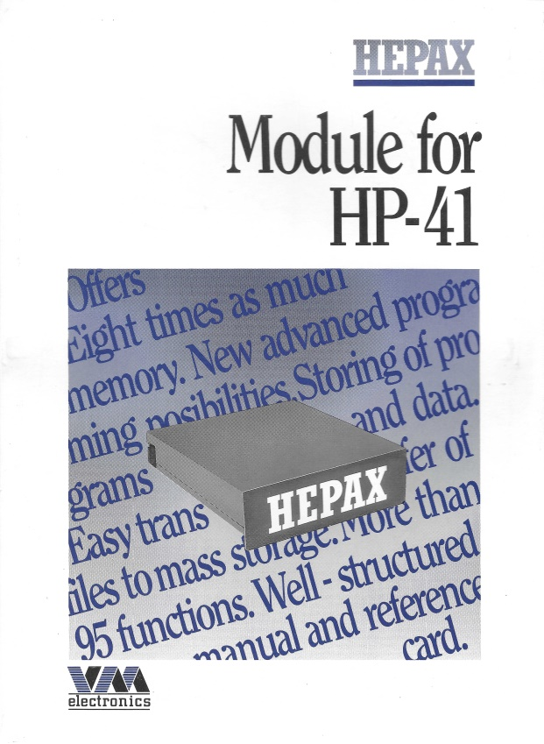
Market Reception
The module received very positive reviews
Started with the pre-ordering to get cash
Product performed really well – however did not sell more than 180-200 modules
Significant bug in version 1C – free replacement to 1D
Production yield never got above 70%
Power consumption being too high
11

Slide 12
How it all Ended
When the HEPAX modules finally hit the market, the HP-41 was already an old product and new handheld devices were placed on the market – HP-71, HP-28, HP-42, etc.
Portable computers were also coming out
Basically outside the initial sale to enthusiast and some small run rate business, then we did not hit the sales numbers we expected.
Had to buy components in bulk – we had to buy the next lot of 300 gate arrays. When we received the invoice for this second lot we ran out of cash and we had to close the company – we were broke…
12

Slide 13
What did we Learn?
All in all we created a product we were really happy with and proud of
This was an incredible experience
High-tech start-up company while we were still studying
Worked hard and managed to bring an advanced product to market – without making any money
The HEPAX module got me my first job – and 33 years later I am still with the same company
13

Slide 14
Questions?
14

